Slide 1



A shift to hybrid work in financial services
Financial Services
The pandemic accelerated digital adoption. The most visible change
is the shift to hybrid work. Empower employees with a device portfolio that enables productivity from anywhere.
A hybrid work environment requires more sophisticated and secure devices as well as communications and collaboration tools to empower employees to work and connect with colleagues and customers from anywhere.
“Thanks to the touchscreen capabilities on Microsoft Surface Pro, we were able to go paperless in our customer engagements. The customer experience is modern and seamless. Plus, we are reducing our carbon footprint and enjoying greater cost savings.”
Microsoft Surface for Business offers a versatile device portfolio with industry-leading security to empower financial services professionals to work from anywhere while delivering more personalized and differentiated customer experiences.
Light, mobile, and powerful, Surface devices deliver value and a premium experience that fits the needs of all personas in financial services, from branch workers, mortgage lenders, and wealth advisors to investment analysts and executives and their staff.
Kyung Hee Jeong, Senior Manager, KDB Hanam Branch, KDB Bank
Surface devices with Windows 11 and Microsoft 365 help financial services companies enable hybrid work while mitigating risk with:
Productivity and collaboration
Cloud-managed devices
Chip-to-cloud security
Experience the best of Microsoft—Microsoft 365, Dynamics 365, Azure, Windows—on a Surface device. Surface + Microsoft Teams enable crystal clear meetings with high-end cameras, optimized microphones, and quality speakers. Digital whiteboards and real-time pen and inking capabilities help teams brainstorm and innovate.
Enable work from anywhere while keeping control with zero-touch deployment and seamless device management. Users just unbox and log in. Surface + Microsoft 365 gives employees the freedom to work their way and protection by the best modern security and manageability platform from Microsoft.
Security is built into every layer, from the supply chain to the firmware to the operating system, helping to keep data safer than ever. Surface powered by Microsoft 365 helps improve enterprise security. Secured-core PCs, available on select Surface devices, are designed to elevate the benefits of Windows 11 security.
Learn more about Surface for Business

Slide 2
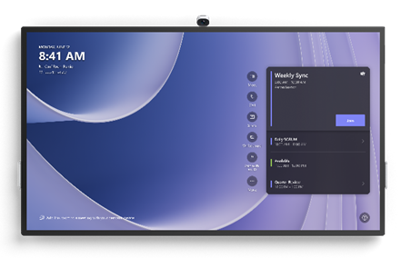
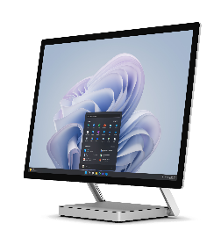
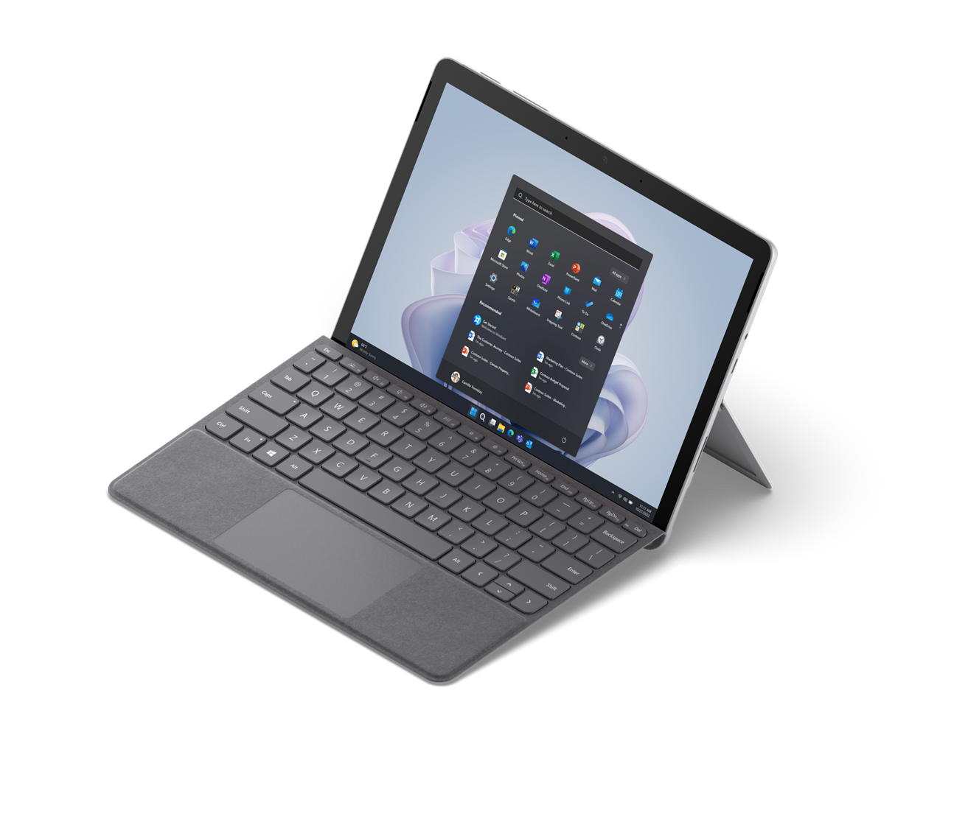
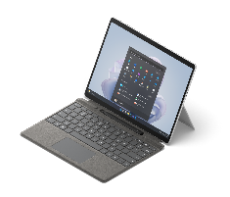
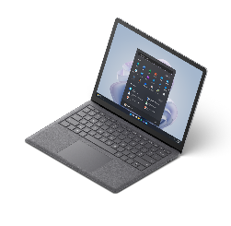




Financial Services
Go
Pro
Laptop
Studio
Hub
Branch workers/Mortgage lenders
Wealth advisors
Challenges
Providing a personalized experience for customers
Staying productive and connected on branch floor or home
Communicating new services clearly to customers
Updating customer data accurately and securely
Challenges
Collaborating with colleagues to determine the best financial plans for clients
Staying productive when working from home or traveling to clients’ locations
Keeping sensitive client data secure
If you prefer to showcase Surface Pro 8 LTE, swap in this copy
Deliver differentiated customer experiences with
Surface Go 4
The smallest and lightest Surface 2-in-1 and extended battery life³ makes it easy to greet customers on the branch floor
Premium design projects bank’s premium image to clients
Faster processor speed (than previous Surface Go) to run critical banking and productivity apps
10.5” PixelSense™ high-resolution touchscreen to show promotional images and videos in brilliant detail
Surface Pen* for digital note taking and e-signatures
Quality speakers, mics, and front/rear cameras for video calls with clients or capturing photos of documents
A Secured-core PC to elevate Windows 11 security benefits
Help clients plan their financial futures with
Surface Pro 9
Full laptop power and the versatility of a tablet with choice of Intel® Evo™ 5 or Microsoft SQ® 3 with 5G²
Lightweight, ultra-thin 2-in-1 device with long-lasting battery³ enables wealth advisors to work with clients in new ways
A Secured-core PC to elevate Windows 11 security benefits
Powerful processors to run business apps and intensive reports
13” PixelSense™ touchscreen designed for digital pen* great for paperless note taking and e-signatures during client visits
High quality audio and video for more effective video calls
The ultimate desktop experience with Thunderbolt™ 4 or USB-C® ports and Windows 11
Help clients plan their financial futures with
Surface Pro 8 LTE
Ultra-light and versatile 2-in-1 device and long-lasting battery³ adapts to the new ways wealth advisors work with clients
Premium design projects bank’s premium image to clients
Powerful processors to run business apps and intensive reports
13” PixelSense™ high-resolution touchscreen + Surface Pen* for digital note taking and e-signatures during client visits
High-end cameras, optimized microphones, and quality speakers for more effective collaboration and client video calls
The ultimate desktop experience with Thunderbolt™ 4 ports and Windows 11
LTE¹ for anywhere connectivity
Investment analysts/data scientists
Bank executives
Challenges
Identifying investments that yield optimal ROI
Creating well-researched advice and complex financial models
Communicating investment plans to colleagues and clients
Challenges
Overseeing the health of the business and well-being of clients
Providing leadership across multi-functional teams
Collaborating on business development plans
Being a positive reflection of the organization’s brand
If you prefer to showcase Surface Studio 2+ or Surface Hub 3, swap in this copy
Create the ultimate productivity workspace with
Surface Studio 2+
Innovative design and strikingly large 28” PixelSense™ touchscreen transforms executive space to a clutter-free desk
Powerful processors empower multitasking: lead video calls, open large files, and fly through presentations with ease
High-quality HD camera, optimized microphones, quality speakers for meaningful connections on video calls
A Secured-core PC to elevate Windows 11 security benefits
Help determine the best investments with
Surface Laptop Studio 2
The most powerful Surface helps handle compute demands of business-critical software and complex financial models
Three modes (Laptop mode, Stage mode, Studio mode) that adapt to how analysts want to work
The ultimate desktop experience with Thunderbolt™ 4 ports and Windows 11
High-end cameras, optimized microphones, quality speakers for effective hybrid meetings
A Secured-core PC to elevate Windows 11 security benefits
Lead the workforce and deliver top results with
Surface Laptop 5
Sleek, thin, and light; an ideal laptop for hybrid work
Choice of 13.5” or 15” HD PixelSense™ touchscreen display
Powerful processors to run business-critical software, financial reports, and productivity apps
High-end cameras, optimized microphones, quality speakers to see and hear colleagues and clients clearly on video calls
The ultimate desktop experience with USB-C® and Thunderbolt™ 4 ports and Windows 11
A Secured-core PC to elevate Windows 11 security benefits
Empower team collaboration with
Surface Hub 3
Premium design projects bank’s premium image to clients
Microsoft Teams-certified meetings platform + high-end cameras, optimized microphones, and quality speakers enables effective hybrid (in-person + remote) meetings
Large, 4K screen to share figures with stakeholders
85” for large-room solution, 50” for smaller spaces
Pen, inking, and whiteboard capabilities to ideate new plans
Wall-mounted or lightweight and mobile (with stand + battery*) to make any space a teamwork space
* Sold separately.
¹ LTE functionality available on select configurations only. Service availability and performance subject to service provider’s network. Contact your service provider for details, compatibility, pricing, SIM card, and activation. See all specs and frequencies at surface.com.
² 5G not available in all areas; compatibility and performance depends on carrier network, plan and other factors. See carrier for details and pricing.
³ Battery life varies significantly based on usage, network and feature configuration, signal strength, settings and other factors. See aka.ms/SurfaceBatteryPerformance for details.

