Slide 1




You don’t have to
be big to dream big
Why think small just because you’re a smaller business? Advances in technology let you set your sights higher and reach for more ambitious goals. Built for the next wave of AI-powered work, Surface Copilot+ PCs¹ allow you to dream big and stay competitive, today and tomorrow.
Thinking small
Dreaming big
“Just the basics will do”
“We need smart, flexible performance
as we grow”
With powerful processors,^{2,3} on-device AI acceleration, and faster, smarter Windows Search,⁴
Surface Copilot+ PCs enable your teams to multitask with more efficiency and deliver
faster results even when the pressure is on.
18.8 hours of increased productivity with Surface⁵
Thinking small
Dreaming big
“Proper security can come later”
“Continuous security designed
for mobility”
Turn security into a business advantage. Employees can do their best work anywhere
and anytime,⁶ since Surface devices are protected from chip to cloud,⁷ include a built-in
Microsoft Pluton security processor, and offer passwordless authentication.
25% more efficient device management and security⁵
Thinking small
Dreaming big
“We’ll figure out AI as we go”
“We need an AI strategy that
levels us up now”
By integrating advanced AI capabilities directly into hardware and software,
Surface Copilot+ PCs transform the way your teams interact with technology,
enabling your business to stay competitive as workplace AI keeps evolving.

Slide 2
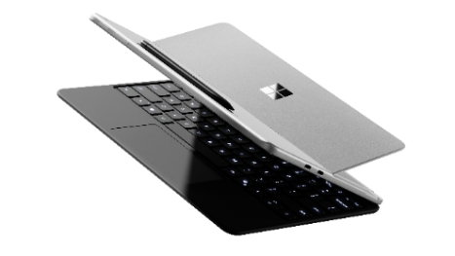
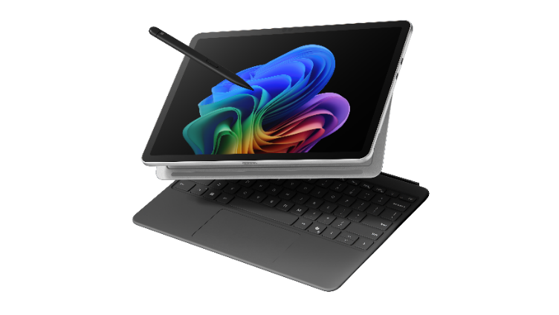
Thinking small
Dreaming big
“We use different devices for
different tasks”
“I'm more agile with one versatile device
that handles all my range of tasks”
Surface Copilot+ PCs easily adapt to changes in the workday, switching from laptop to tablet⁸
to help teams deliver in the moment. Natural typing, precise inking, and responsive
touchscreens speed up responses to problems and prospects.
Thinking small
Dreaming big
“Collaboration isn't always possible
and that's okay”
“Our remote and hybrid teams depend
on effortless connection”
The faster you grow, the easier it becomes to make expensive mistakes. Surface keeps you
looking sharp with a 1080p Full HD camera, high-quality Studio Mics, and live captions for
real-time translation of over 40 languages into English.⁹
Thinking small
Dreaming big
“Adapting to AI will take time”
“AI will give us a boost now”
Surface Copilot+ PCs with Al-enhanced features contribute to an average of 30.4 hours of
increased employee productivity per device per year.⁵ Don’t take our word for it, take IDC’s.
Read their white paper The Business Value of Microsoft Surface.
      Backed by Surface Copilot+ PCs, even smaller teams
      can implement big ideas. Get more information about
      devices that can take you forward when it matters most.
On some devices, Copilot+ PC experiences require free updates continuing to roll out through early 2025. Timing varies by device and region. See aka.ms/copilotpluspcs
Intel® AI Boost with 48 TOPS on Intel® Core™ Ultra 7 processor 266V and Intel® Core™ Ultra 7 processor 268V.
Snapdragon® X Plus (8 Core) processor with 45 TOPS.
Improved Windows Search works with specific text, image and document formats only; optimized for select languages [English, Chinese (Simplified), French, German, Japanese and Spanish].
IDC White Paper commissioned by Microsoft, “The Business Value of Microsoft Surface,” April 2025.
Requires internet connection and/or subscription; features may vary by region or device.
Shield sensitive information including user credentials from chip to cloud with Microsoft Pluton, Windows Hello, and BitLocker to protect against data loss and theft.
Surface Pro Flex Keyboard sold separately.
Live Captions with translation for video and audio subtitles into English from 40+ languages available now on Copilot+ PCs with Snapdragon® X Series processors and on other devices starting early 2025. Translation from 27 languages into Chinese (Simplified) coming later this year. Learn more.

