Slide 1
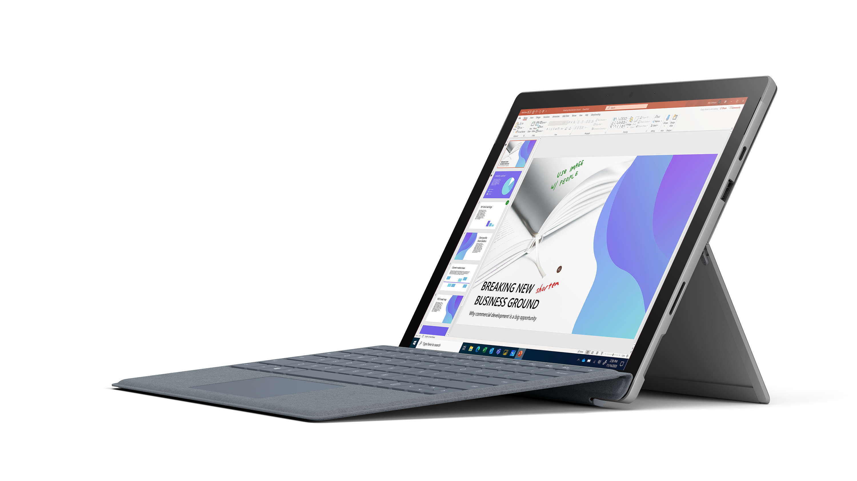
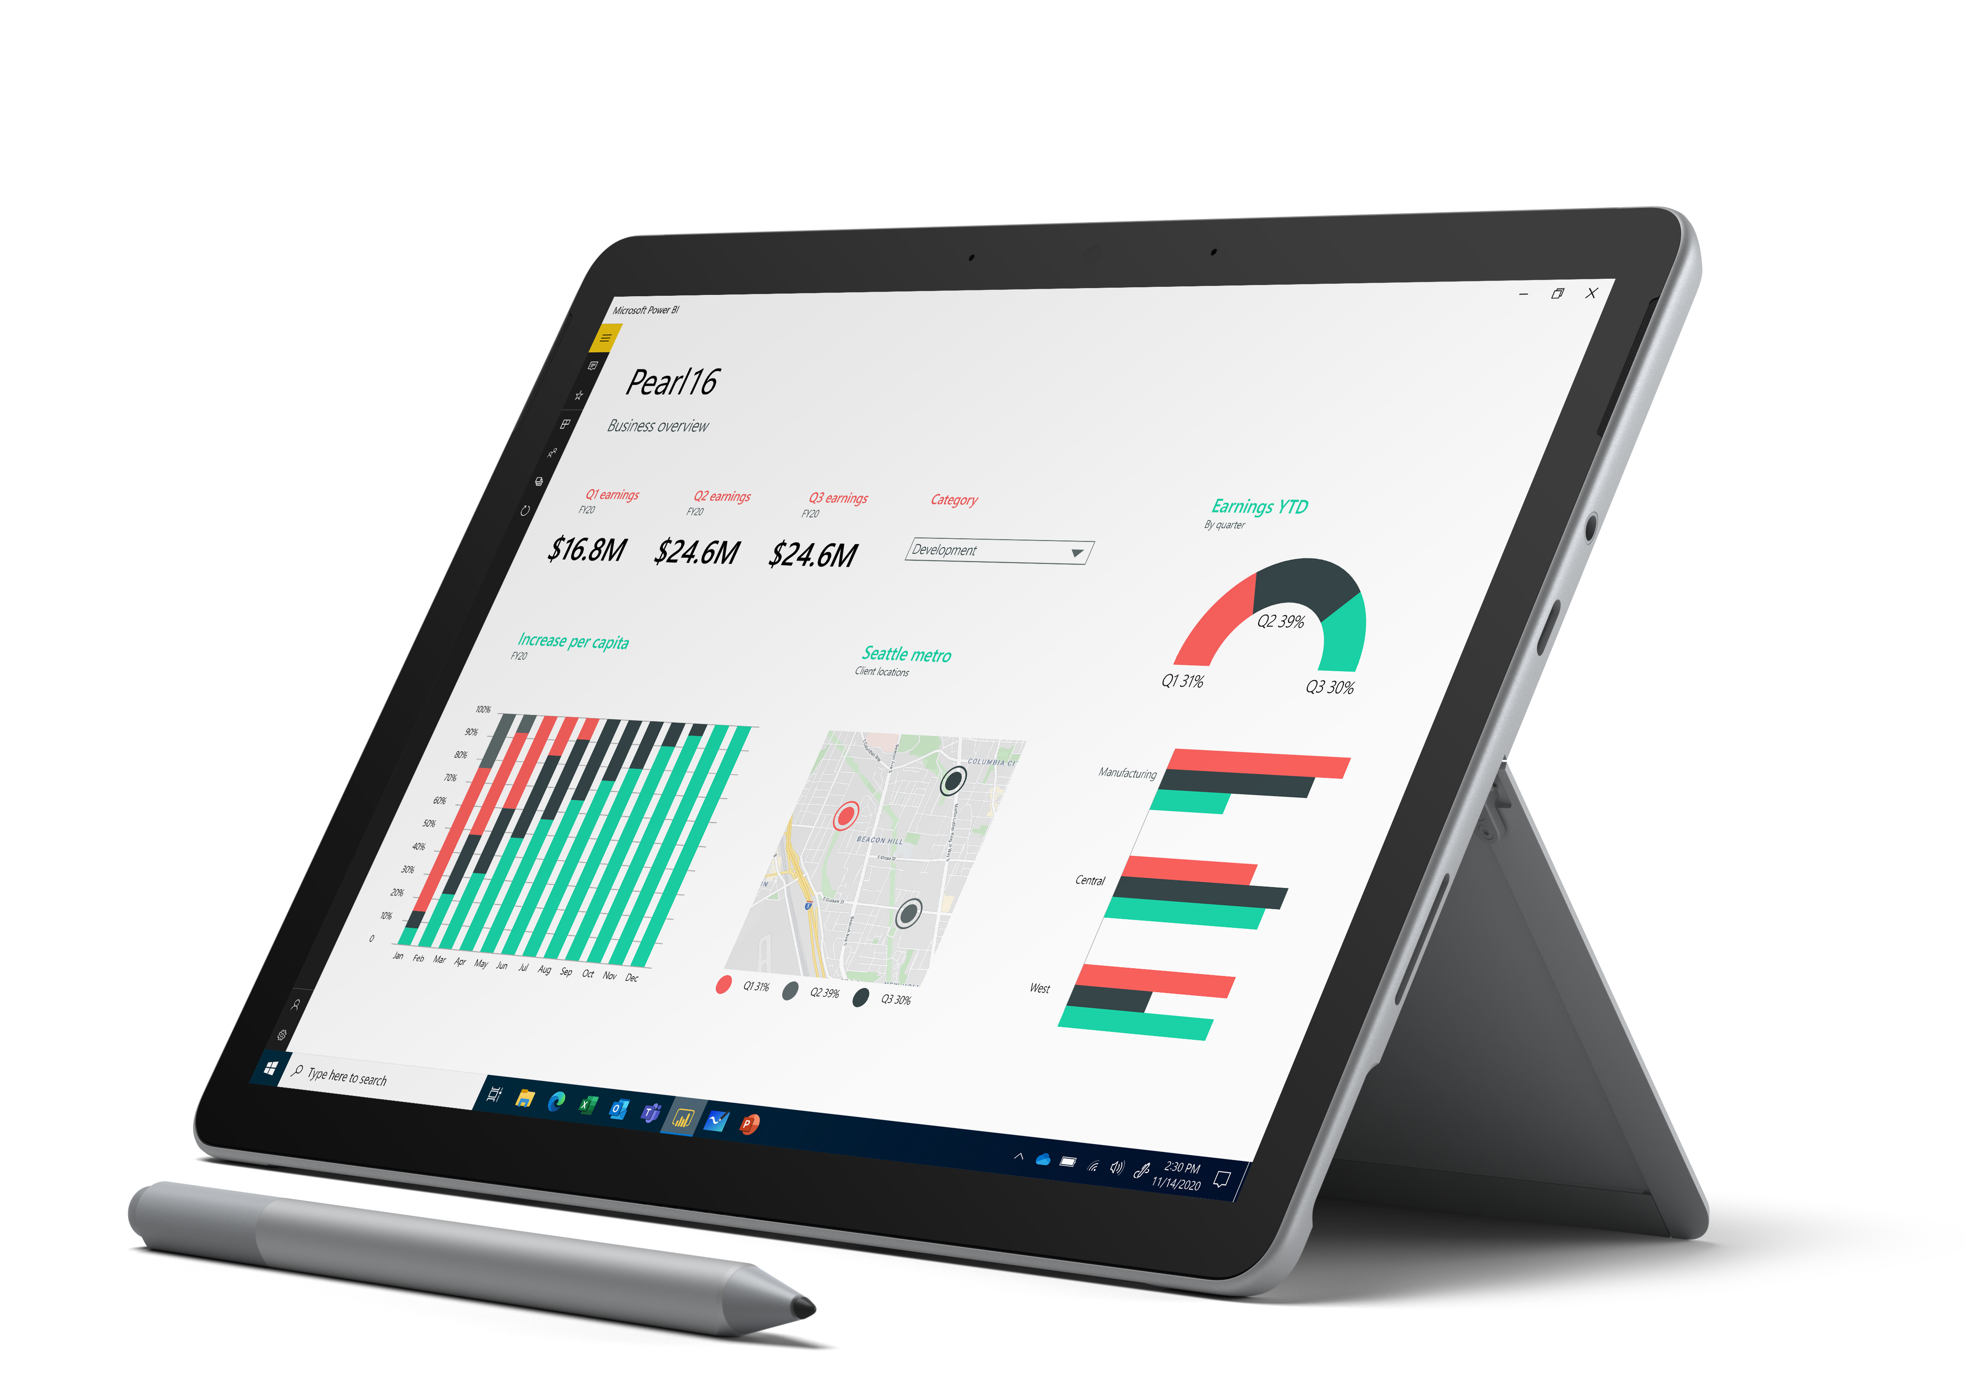
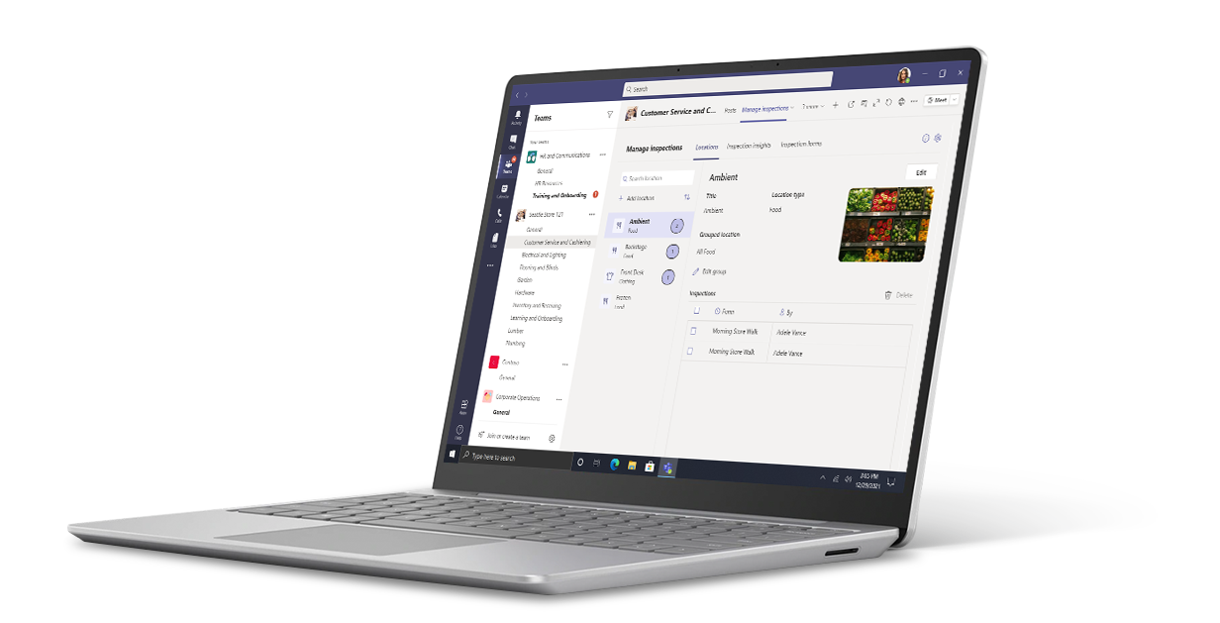
Empower your frontline workers with Surface devices
From powerful laptops to agile 2-in-1s, improve productivity from anywhere.
Surface Pro 7+
Lightweight and versatile 2-in-1
Surface Laptop Go
The essential, everyday laptop
Surface Go 2
Portable power
Ultra-light 2-in-1 with a 12.3” PixelSense™ touchscreen display, starting at just 1.70 lb¹
All-day battery life up to 15 hours,² up to 13.5 hours with LTE
Keep your workforce securely connected with optional LTE Advanced³
Go paperless and collect digital signatures with Surface Pen⁴
2.1 times faster than before with an 11th Gen Intel® Core™ Processor
Lightest and smallest laptop, at just 2.45 lb¹ with a 12.4” PixelSense™ touchscreen display
All-day battery life up to 13 hours²
Recharge quickly with Fast Charging—up to 80% in just over an hour⁵
Get to work quickly with One Touch sign-in with the Fingerprint Power Button on select models, plus fast, secure data access
Use durable tech cases for all-day device protection⁴
Compact and light 2-in-1 with a 10.5” PixelSense™ touchscreen display, starting at just 1.2 lb¹
All-day battery life up to 10 hours²
Keep your remote team connected with optional LTE Advanced⁴
Enable employees to work from anywhere with a built-in kickstand and touchscreen
Connect to displays and docking stations or charge accessories with USB-C® port
1 Weight not including Type Cover or Keyboard.
2 Battery life varies significantly with settings, usage, and other factors. See Surface.com for full battery life details.
3 Service availability and performance subject to service provider’s network. Contact your service provider for details, compatibility, pricing, SIM card, and activation. See all specs and frequencies at Surface.com.
4 Surface Pen and accessories sold separately.
5 Testing conducted at Microsoft in September 2020 using pre-production devices and software. Tested with the inbox SurfLink 39W PSU under controlled conditions with device in hibernate or off state. Device was powered on to desktop screen with default display brightness settings. Actual charge time will vary based on operating conditions. Measured at typical office ambient temperature of 23C.

