Slide 1
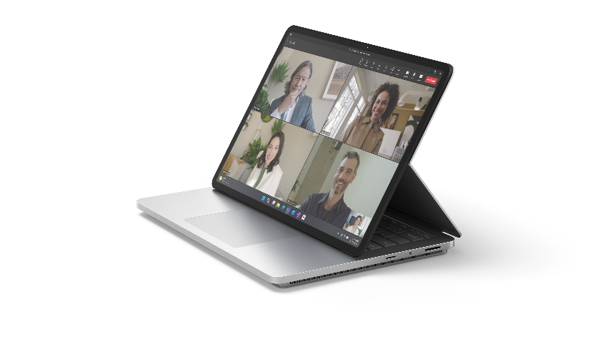
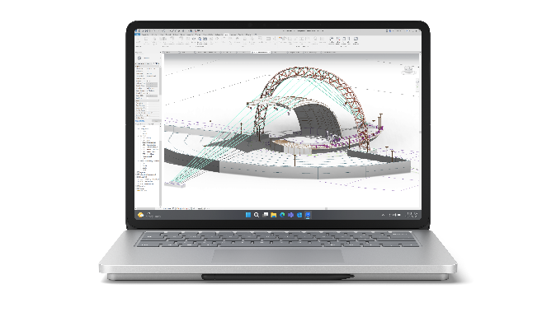
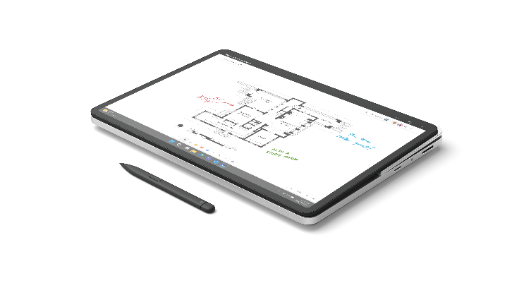
Microsoft Surface Laptop Studio 2
The versatility to create. The power to perform.
Reimagine education with the most powerful Surface ever. Surface Laptop Studio 2 delivers powerful performance in a revolutionary design that seamlessly transitions between modes.
Go from a touchscreen laptop to the perfect angle for virtual classes or a portable canvas, all at the fast pace of modern education. With Microsoft security and innovative Windows 11 features enabled out of the box, Surface Laptop Studio 2 is the ultimate powerhouse laptop for researchers, STEM or creative students, and school leaders.
DESIGNED FOR PERFORMANCE
VERSATILITY FOR ANY CHALLENGE
The most powerful Surface delivers over 2x more computing power and your choice of powerful NVIDIA GPUs for multitasking, research, and demanding technical or design apps.¹
Give educators and students the power to tackle any challenge, whether they’re compiling research data, multitasking across 4K displays, jumping between classes, or sketching out equations.
EMPOWER CREATIVITY AND COLLABORATION
DEPLOY, MANAGE, AND STAY SECURED FROM ANYWHERE
Elevate research and collaborative learning through a high-quality touchscreen, Studio Camera, speakers, mics, and all the ports your educators, staff, and students need.
Protect school, staff, and student data with Secured-core PCs and chip-to-cloud security² as IT saves time
and money through modern deployment
and management.
New Studio Camera with a wide field of view and AI-powered features
Vibrant 14.4”³ PixelSense™ Flow touchscreen with a refresh rate up to 120hz
A more serviceable design that minimizes downtime⁴
Seamless transitions between three different modes through the dynamic woven hinge
Omnisonic® speakers and far-field Studio Mics featuring Voice Clarity⁵
Consistent productivity with all-day battery life⁶
Inking like pen on paper with Surface Slim Pen 2⁷
¹Available as an option on certain of Surface Laptop Studio 2.
²Some cloud-enabled features and functionality require paid subscription and/or qualifying license.
³Surface Laptop Studio 2 display has rounded corners within a standard rectangle. When measured as a standard rectangular shape the screen is 14.36” diagonally (actual viewable area is less).
⁴Customer Replaceable Units (CRUs) are components available for purchase through your Surface Commercial Authorized Device Reseller. Components can be replaced on-site by a skilled technician following Microsoft’s Service Guide.
Opening and/or repairing your device can present electric shock, fire and personal injury risks and other hazards. Use caution if undertaking do-it-yourself repairs. Device damage caused during repair will not be covered under Microsoft’s Hardware Warranty or protection plans. Components will be available shortly after initial launch; timing of availability varies by component and market.
⁵Voice Clarity requires Windows 11 and is available in apps which use integrated device microphones and use certain Windows audio processing modes.
⁶Battery life varies significantly based on device configuration, usage, network and feature configuration, signal strength, settings and other factors. See aka.ms/SurfaceBatteryPerformance for details.
⁷Sold separately.
PARTNER LOGO

Slide 2
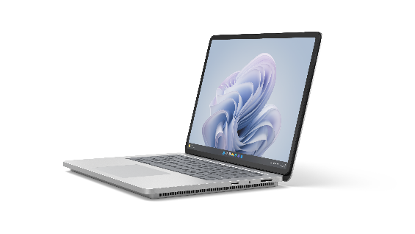
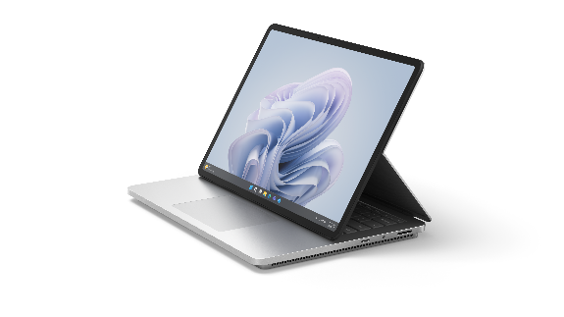
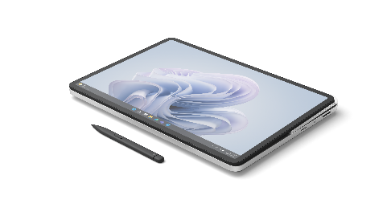
Microsoft Surface Laptop Studio 2
PROCESSOR
13th Gen Intel® Core™ i7- 13800H Processor
Built on the Intel® Evo™ platform
Intel® Gen3 Movidius 3700VC VPU AI Accelerator
MEMORY AND
STORAGE¹
Memory options:
16GB, 32GB or 64GB LPDDR5x RAM
Storage options:
Removable² solid-state drive (Gen 4 SSD) options: 512 GB, 1TB or 2TB
SIZE AND WEIGHT⁵
Length: 12.72 inch (323 mm)
Width: 9.06 inch (230 mm)
Height: 0.86 inch (22 mm)
Weight:
Intel® Iris® Xe graphics model:
4.18 lbs (1.89kg)
NVIDIA® graphics models:
4.37 lbs (1.98 kg)
GRAPHICS
Graphics options:
NVIDIA® GeForce RTX™ 4050 Laptop GPU with 6GB GDDR6 vRAM
2130 MHz boost clock speed, 80W maximum graphics power
NVIDIA® GeForce RTX™ 4060 Laptop GPU with 8GB GDDR6 vRAM
2010 MHz boost clock speed, 80W maximum graphics power
NVIDIA® RTX™ 2000 Ada
Generation Laptop GPU with 8GB GDDR6 vRAM
2115 MHz boost clock speed, 80W maximum graphics power
Intel® Iris® Xe Graphics
Touchscreen: 14.4”³ PixelSense™ Flow Display Resolution: 2400 x 1600 (200 PPI)
Refresh rate: up to 120Hz Aspect ratio: 3:2
Contrast ratio 1500:1
Color profile: sRGB and Vivid Individually color-calibrated display
VESA DisplayHDR 400 certified
Dolby Vision IQ^{®4} support Touch: 10-point multi-touch Corning® Gorilla® Glass 5 display
DISPLAY
¹System software uses significant storage space. Available storage is subject to change based on system software updates and apps usage. 1 GB = 1 billion bytes. 1 TB = 1,000 GB. See Surface.com/Storage for more details.
²Customer Replaceable Units (CRUs) are components available for purchase through your Surface Commercial Authorized Device Reseller. Components can be replaced on-site by a skilled technician following Microsoft’s Service Guide. Opening and/or repairing your device can present electric shock, fire and personal injury risks and other hazards. Use caution if undertaking do-it-yourself repairs. Device damage caused during repair will not be covered under Microsoft’s Hardware Warranty or protection plans. Availability of replaceable components and service options may vary by market and/or at initial product launch.
³Surface Laptop Studio 2 display has rounded corners within a standard rectangle. When measured as a standard rectangular shape the screen is 14.36” diagonally (actual viewable area is less).
⁴Requires Dolby Vision® encoded content and video.
⁵Might vary depending on manufacturing processes.
PARTNER LOGO

Slide 3
Microsoft Surface Laptop Studio 2
BATTERY
LIFE⁶
Intel® Iris® Xe graphics model: up to 19 hours of typical device usage
NVIDIA® graphics models (except 2 TB SSD): up to 18 hours of typical device usage 2 TB SSD NVIDIA® graphics models: up to 16 hours of typical device usage
CAMERAS
Full HD front-facing Surface Studio Camera
1080p Full HD camera with wide field of view
Windows Studio Effects with auto framing, eye contact, and background blur
Windows Hello 2.0 face authentication camera
NETWORK AND CONNECTIVITY
Wi-Fi 6E: 802.11ax compatible Bluetooth® Wireless 5.3 technology
PEN AND ACCESSORIES
COMPATIBILITY
Designed for Surface Slim Pen 2⁹ and supports tactile signals
Integrated Surface Slim Pen 2⁹ storage for charging under the keyboard
Supports Microsoft Pen Protocol (MPP)
SECURITY
Hardware TPM 2.0 chip for enterprise-grade security and BitLocker support
Enterprise-grade protection with Windows Hello 2.0 face sign-in
Windows 11 Secured-core PC
AUDIO
Dual far-field Studio Mics with Voice Clarity⁷
Quad Omnisonic® speakers with Dolby® Atmos^{®8}
SOFTWARE
Windows 11 Pro
Preloaded Microsoft 365 Apps¹⁰
Microsoft 365 Business
Standard, Microsoft 365 Business Premium, or Microsoft 365 Apps 30-day trial¹¹
PORTS
2 x USB-C® with USB4®/Thunderbolt™ 4 (with DisplayPort and Power Delivery)
USB-A 3.1
MicroSDXC card reader
3.5 mm headphone jack Surface Connect port
⁶Up to 19.0 hours of battery life based on typical Surface device usage on Surface Laptop Studio 2 with Intel® Core™ i7-13700H Processor, 512GB, 16 GB RAM - Testing conducted by Microsoft in July-August 2023 using preproduction Windows 11 software and preproduction Surface Laptop Studio 2 Intel® Core™ i7-13700H Processor, 512GB, 16GB RAM devices. Testing consisted of full battery discharge with a mixture of active use and modern standby. The active use portion consists of (1) a web browsing test accessing eight popular websites over multiple open tabs, (2) a productivity test utilizing Microsoft Word, PowerPoint, Excel, OneNote and Outlook, and (3) a portion of time with the device in use with idle applications. All settings were default except screen brightness was set to 150 nits with Auto-Brightness, Adaptive Color, and Smart Charging disabled. Wi-Fi was connected to a network. Tested with Windows 11 Version 10.0.22621 (22H2). Battery life varies significantly with settings, usage, and other factors.
Up to 18.0 hours of battery life based on typical Surface device usage on Surface Laptop Studio 2 with Intel® Core™ i7-13700H Processor, NVIDIA® GeForce™ RTX 4050 Laptop GPU, 512GB, 16GB RAM. Testing conducted by Microsoft in July-August 2023 using preproduction Windows 11 software and preproduction Surface Laptop Studio 2 Intel® Core™ i7-13700H Processor, NVIDIA® GeForce™ RTX 4050 Laptop GPU, 512GB, 16GB RAM devices. Testing consisted of full battery discharge with a mixture of active use and modern standby. The active use portion consists of (1) a web browsing test accessing eight popular websites over multiple open tabs, (2) a productivity test utilizing Microsoft Word, PowerPoint, Excel, OneNote and Outlook, and (3) a portion of time with the device in use with idle applications. All settings were default except screen brightness was set to 150nits with Auto-Brightness, Adaptive Color, and Smart Charging disabled. Wi-Fi was connected to a network. Tested with Windows 11 Version 10.0.22621 (22H2). Battery life varies significantly with settings, usage, and other factors.
Surface Laptop Studio 2 with Intel® Core™ i7-13700H Processor, NVIDIA® GeForce™ RTX 4060 Laptop GPU, 2TB, 64GB RAM Testing conducted by Microsoft in July-August 2023 using preproduction Windows 11 software and preproduction Surface Laptop Studio 2 Intel® Core™ i7-13800H Processor, NVIDIA® GeForce™ RTX 4060 Laptop GPU, 2TB, 64GB RAM devices. Testing consisted of full battery discharge with a mixture of active use and modern standby. The active use portion consists of (1) a web browsing test accessing eight popular websites over multiple open tabs, (2) a productivity test utilizing Microsoft Word, PowerPoint, Excel, OneNote and Outlook, and (3) a portion of time with the device in use with idle applications. All settings were default except screen brightness was set to 150nits with Auto-Brightness, Adaptive Color, and Smart Charging disabled. Wi-Fi was connected to a network. Tested with Windows 11 Version 10.0.22621 (22H2). Battery life varies significantly with settings, usage, and other factors.
⁷Voice Clarity requires Windows 11 and is available in apps which use integrated device microphones and use certain Windows audio processing modes.
⁸Requires Dolby Atmos® encoded content and audio.
⁹Sold separately.
¹⁰Sold separately. Software license required for some features.
¹¹Activation required. If your device is managed by your organization’s IT department, contact your IT administrator for activation. If you activate your trial outside your organization, after 30 days, you will be charged the applicable monthly or annual subscription fee. Credit card required. Cancel any time to stop future charges. See https://aka.ms/m365businesstrialinfo.
PARTNER LOGO

Slide 4
Microsoft Surface Laptop Studio 2
ACCESSIBILITY
Surface Precision Haptic touchpad with adjustable click sensitivity, right click area, and adaptive touch mode Compatible with Surface Adaptive Kit
Compatible with Microsoft Adaptive Accessories Includes Windows Accessibility Features – Learn More Accessibility Features | Microsoft Accessibility Discover more Microsoft Accessible Devices & Products – Accessible Devices & Products for PC & Gaming | Assistive Tech Accessories - Microsoft Store
SERVICEABILITY
Replaceable components include:²
SSD
AB cover module (display)
C cover (including: keyboard, touchpad and pen charger) D-Plate + battery Motherboard
Cosmetic plate Charging Port (Surface Connect connector) MicroSDXC card reader
USB-C® and USB-A ports connectors
Audio jack
WHAT'S IN THE BOX
Surface Laptop Studio 2 Power supply:
Intel® Iris® Xe graphics model: 102W
NVIDIA® graphics models: 127W
Quick start guide Safety and warranty documents
KEYBOARD LAYOUT
Activation: Moving (mechanical) keys
Layout: QWERTY, full row of function keys (F1-F12) Windows key and dedicated buttons for media controls, screen brightness and mute Backlight
Precision Haptic touchpad
EXTERIOR
Casing: Anodized aluminum Color: Platinum
SUSTAINABILITY
Sustainable Products & Solutions | Microsoft CSR
HINGE
Dynamic Woven Hinge made of woven fabric
WARRANTY¹²
1-year limited hardware warranty
SENSORS
Auto brightness via Ambient Color Sensor
Accelerometer Gyroscope
Battery capacity Nominal (WH) 58
Battery capacity Min (WH) 56
BATTERY CAPACITIES⁵
²Customer Replaceable Units (CRUs) are components available for purchase through your Surface Commercial Authorized Device Reseller. Components can be replaced on-site by a skilled technician following Microsoft’s Service Guide. Opening and/or repairing your device can present electric shock, fire and personal injury risks and other hazards. Use caution if undertaking do-it-yourself repairs. Device damage caused during repair will not be covered under Microsoft’s Hardware Warranty or protection plans. Availability of replaceable components and service options may vary by market and/or at initial product launch.
⁵Might vary depending on manufacturing processes.
¹²Microsoft’s Limited Warranty is in addition to your consumer law rights.
PARTNER LOGO

