Slide 1
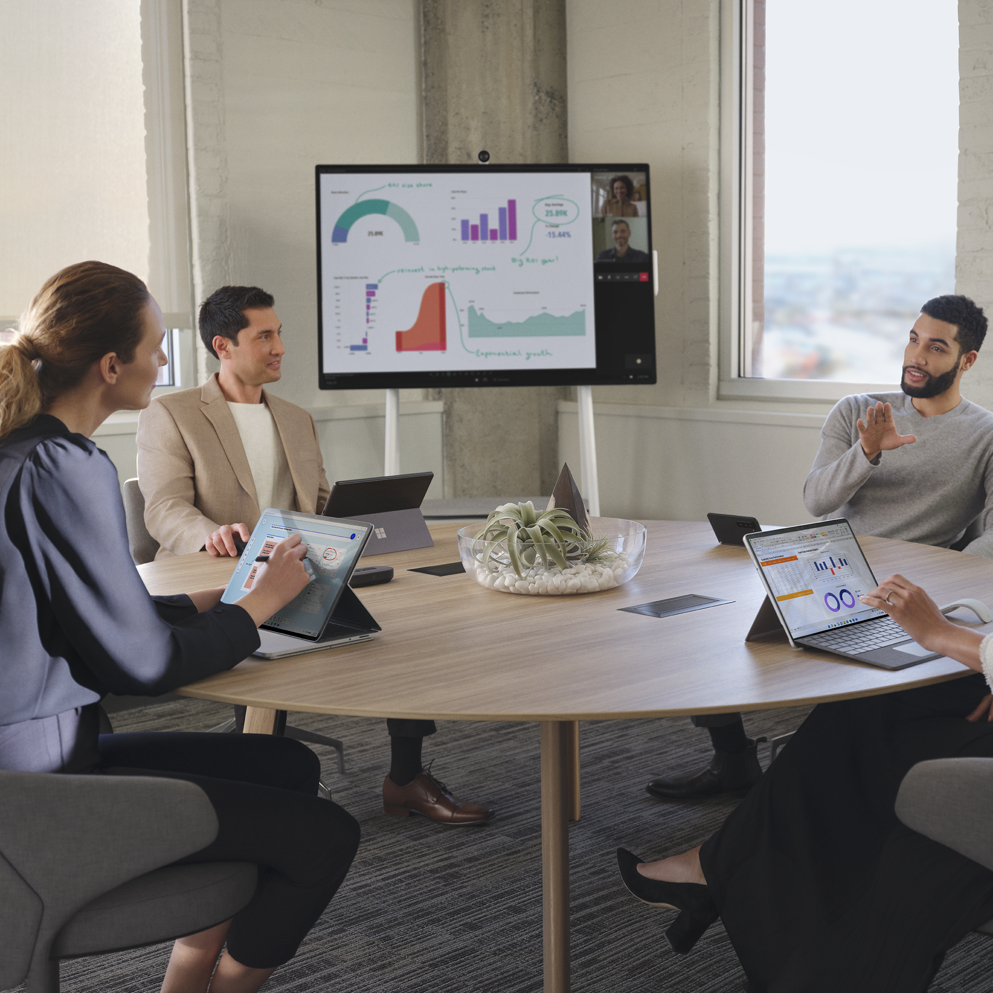
Surface for Nonprofit
Customer Stories

Slide 2
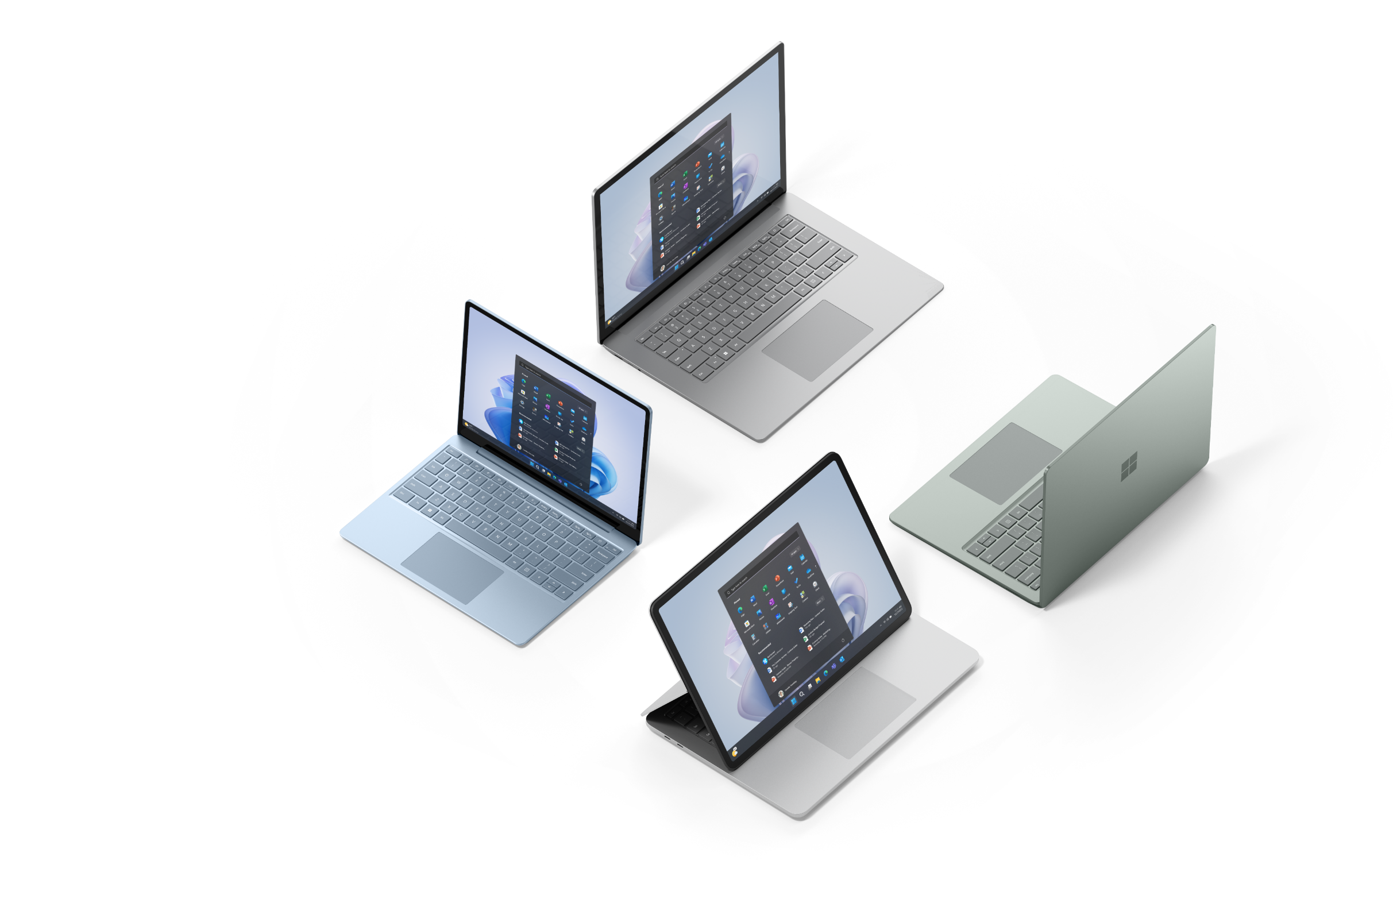
Customer stories

Slide 3

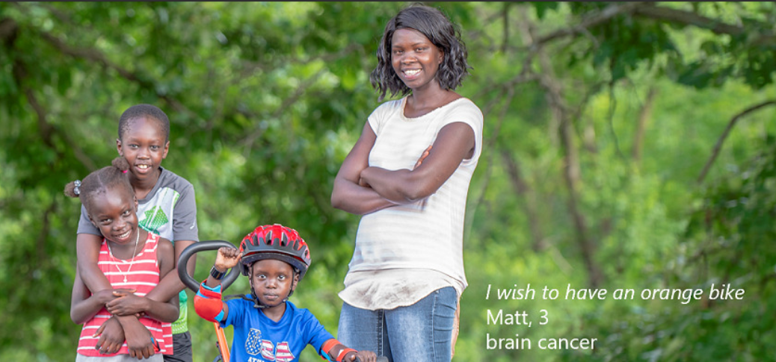
Make-A-Wish America
Customer success story
Make-A-Wish® continues its mission of hope and embraces innovation with help from Surface devices
Vision for digital transformation
Renowned around the world for creating life-changing wishes for children with critical illnesses, Make-A-Wish had a bold new vision to digitally transform its operations. It needed to standardize its IT services and devices across geographically dispersed staff and volunteer teams, and portability and ease-of-use were paramount to maximizing productivity and streamlining operations.
How Surface delivers
Make-A-Wish selected Microsoft Surface Laptop 4 to help transform how it restores hope and joy for wish kids and their families when they need it most.
After converting Make-A-Wish to Office 365 and Azure, adding Surface devices unified the organization so its staff could better focus on the mission. IT and staff are benefitting from a deeply coordinated toolset with Microsoft Teams, Windows Autopilot, Defender for Microsoft 365, Microsoft Endpoint Manager, and Surface Management Portal.
“With Microsoft Surface, we’re providing a highly capable device, reducing down time and decreasing provisioning time with Microsoft Intune and Autopilot. Now Make-A-Wish staff and volunteers can better focus on their passion to serve wish kids across the country.“
— Travis Gibson: CISM: Senior Director of Infrastructure, Security, and Operations, Make-A-Wish America
Business need
Surface device
Organization size
Industry
Country
Learn more
Digital transformation
Surface Laptop 4
Large (1,000–9,999 employees)
Nonprofit
United States
Read the case study

Slide 4

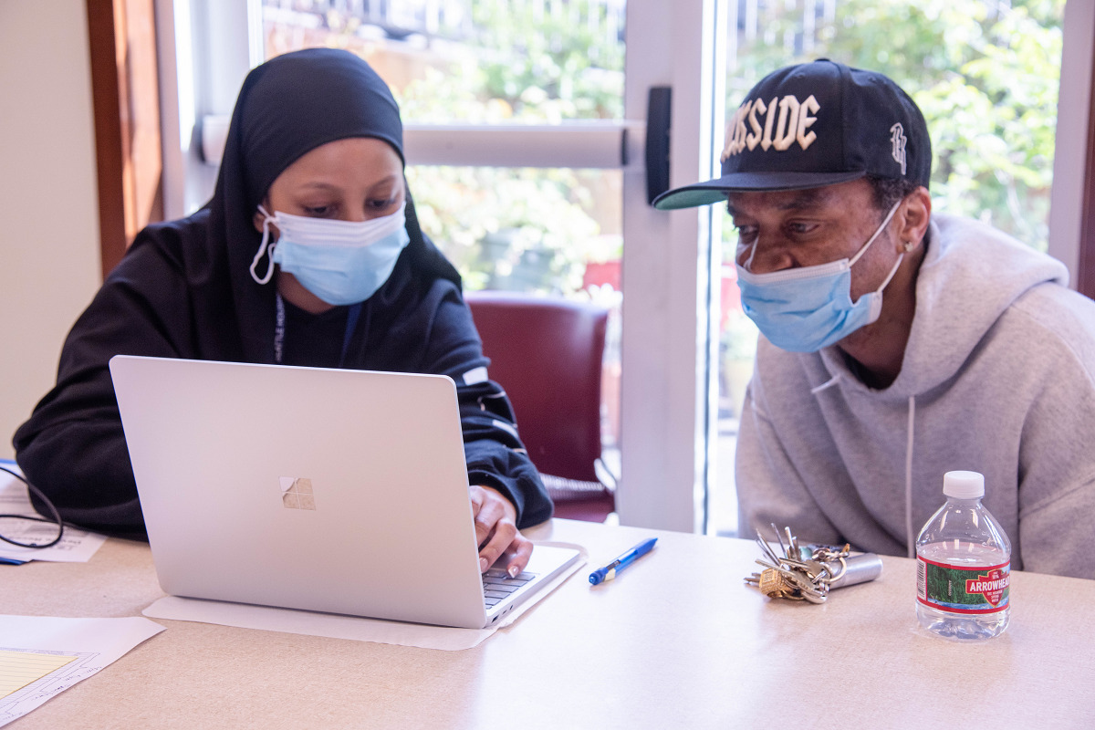
Seattle Housing Authority
Customer success story
The Seattle Housing Authority equips residents with Surface Laptop Go to foster digital equity and accessibility
Making technology more widely accessible to all
Knowing digital skills and access to the right technology would make a difference to thousands of residents in their search for jobs, education, and access to healthcare, the Seattle Housing Authority equipped 2,200 households with their own Surface Laptop Go and Microsoft Home and Student 2021.
How Surface delivers
Mobility was a priority for SHA, so their device choice needed to be both lightweight and durable. Accessibility and cost-effectiveness were also significant criteria. After reviewing several options, SHA decided on the Surface Laptop Go, a lightweight, durable device that offered extensive accessibility features.
The extended accessibility features of Microsoft Windows built into the Surface Laptop Go devices enable users with special needs.
“I got really excited about the accessibility features of the Surface Laptop Go. We have a lot of monolingual residents that speak many different languages. One of the features I liked was the fact that you could change your language and change your keyboard.“
— Maria Ursua: Support Services Coordinator,
Seattle Housing Authority
Business need
Surface device
Organization size
Industry
Country
Learn more
Mobile productivity
Cost effective
Digital equity
Surface Laptop Go
Medium (50–999 employees)
Nonprofit
United States
Read the case study

Slide 5


Barnardo’s
Customer success story
Social services nonprofit enhances client support through Microsoft technology
Meeting the increasing need for essential social services
United Kingdom–based nonprofit connects hundreds of thousands of families and children in need with valuable social services each year. To best make those connections, Barnardo’s must ensure that employees have the technology they need to work efficiently and accurately, and the organization also needs to show potential donors that its work has a concrete impact.
How Surface delivers
By deploying Microsoft Cloud technologies and Microsoft Surface devices, Barnardo’s has helped employees be more effective in the field, and it has gained valuable reporting capabilities that have been essential in securing funding to meet the increased demand for services during COVID-19. The nonprofit chose Surface devices because they are several pounds lighter than comparable products, without sacrificing screen size. That way, frontline users can go wherever they’re most needed, from schools to community centers to homes.
“By adopting Microsoft 365, the Microsoft Cloud, and Surface devices, technology supports what we’re doing and where we’re going as an organization.“
— Kieron Thorpe: Head of Operating Technology, Bernardo's
Business need
Surface device
Organization size
Industry
Country
Learn more
Hybrid work productivity
Surface
Large (1,000–9,999 employees)
Nonprofit
United Kingdom
Read the case study

Slide 6
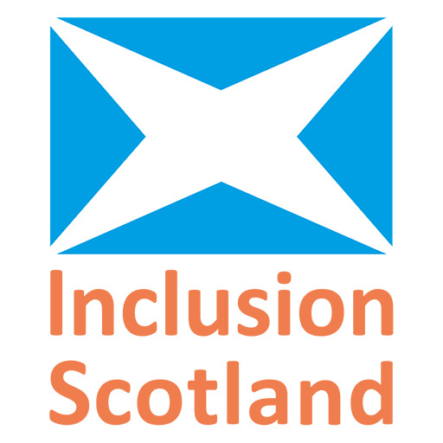
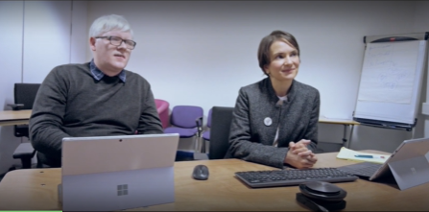
Inclusion Scotland
CUSTOMER SUCCESS STORY
Raising awareness that disabled people can do so much more with Microsoft
The mission
Inclusion Scotland is an organisation that is run by disabled people for disabled people. It works to achieve positive changes to policy and practice, so that disabled people are fully included throughout all Scottish society as equal citizens.
Technology has a key role to play in social inclusion. That’s why Inclusion Scotland chooses to provide its staff with Microsoft Surface devices.
How Surface delivers
Inclusion Scotland staff appreciate Surface devices because of its:
Lightweight form factor and portability
Long battery life
Interoperability with Microsoft’s accessibility tools
Tight integration with Microsoft 365 productivity tools such as Teams
“All the Microsoft tools automatically work with the Microsoft Surface. I use Microsoft Teams to manage my team. It allows people who traditionally wouldn’t have that ability to collaborate to work from home – now they can.”
— Raj Jeyaraj: Head of Operations, Inclusion Scotland
Business need
Surface devices
Organization size
Industry
Country
Learn more
Accessibility tools for social inclusion
Surface Go
Surface Book
Surface Laptop
Small (1-49 employees)
Nonprofit
Scotland
Read the case study and watch the video

Slide 7
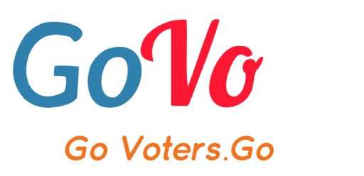
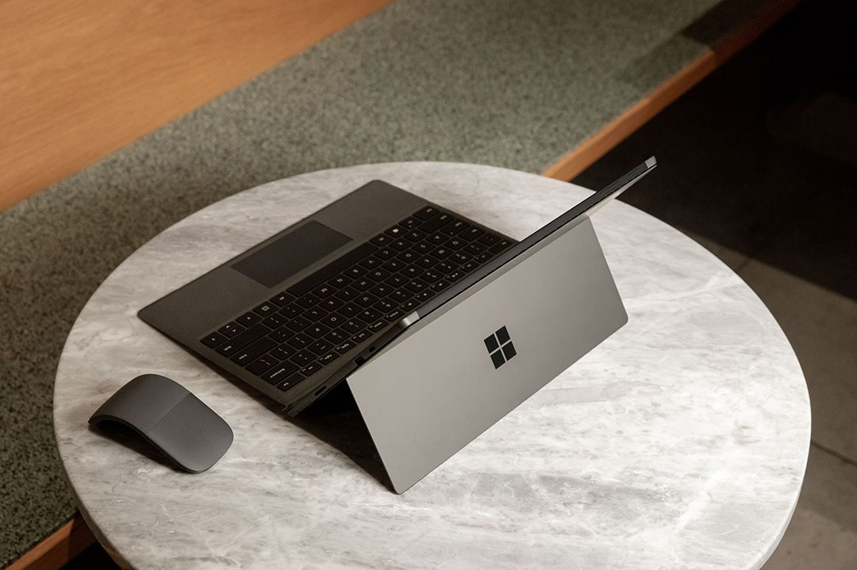
GoVo: Go Voters Go
CUSTOMER SUCCESS STORY
Social entrepreneur brings his vision to life with Surface Pro
The mission
Social activist and entrepreneur Joshua Scott used his Microsoft Surface Pro to create and launch his innovative voting app,
GoVo: Go Voters Go.
How Surface delivers
Ease of use with touchscreen
Portability to work anywhere
Interoperability with Microsoft 365 tools (Teams, Outlook, etc.)
5-megapixel front-facing camera—for Teams meetings
Studio-grade recorder
Impressive graphics capabilities
Surface Pen for creative design
Sleek device aesthetic for inspiration
Surface Headphones with noise cancellation for ideal work environment
“The Surface Pro helped me to start making my vision a reality. That was a game-changer for me.”
— Joshua Scott: Creator and Founder,
GoVo: Go Voters Go
Business need
Surface devices
Organization size
Industry
Country
Learn more
Business productivity
Surface Pro
Surface Laptop
Small (1-49 employees)
Nonprofit
United States
Read the case study

Slide 8
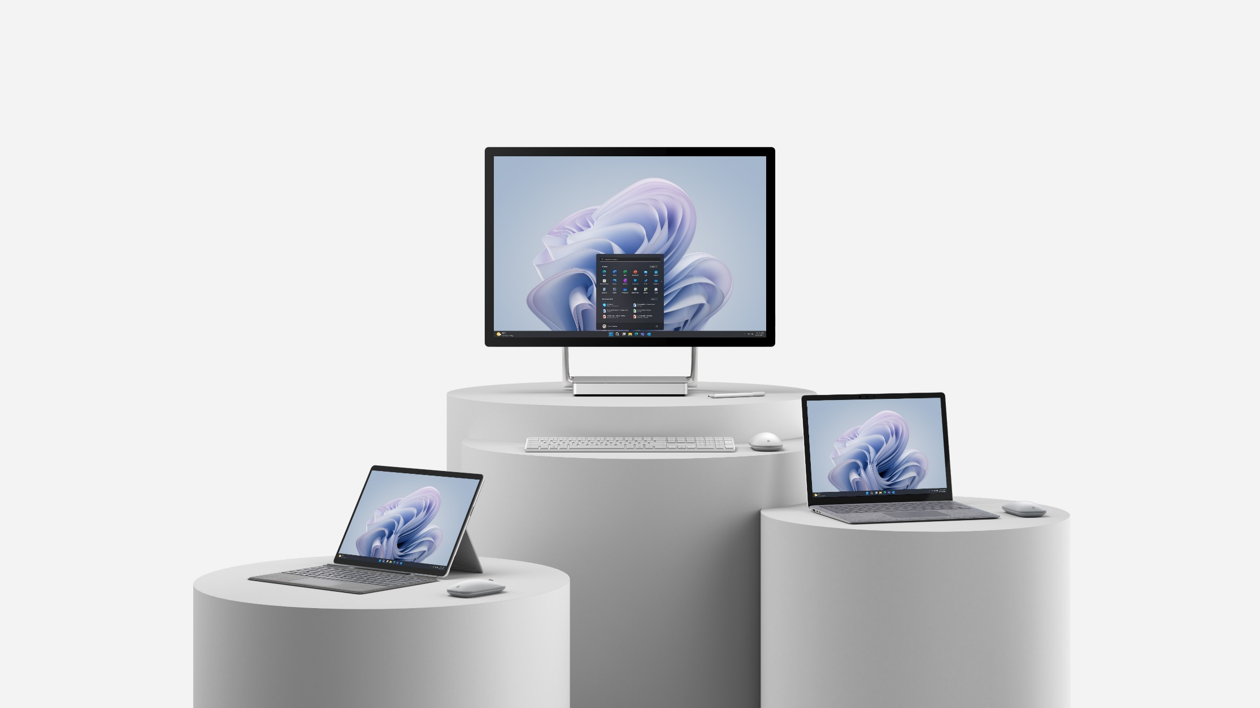
Next steps
Learn more at microsoft.com/surface/business
Request product demos across the portfolio
Schedule a workshop with your partner
or Microsoft Technology Center

Slide 9
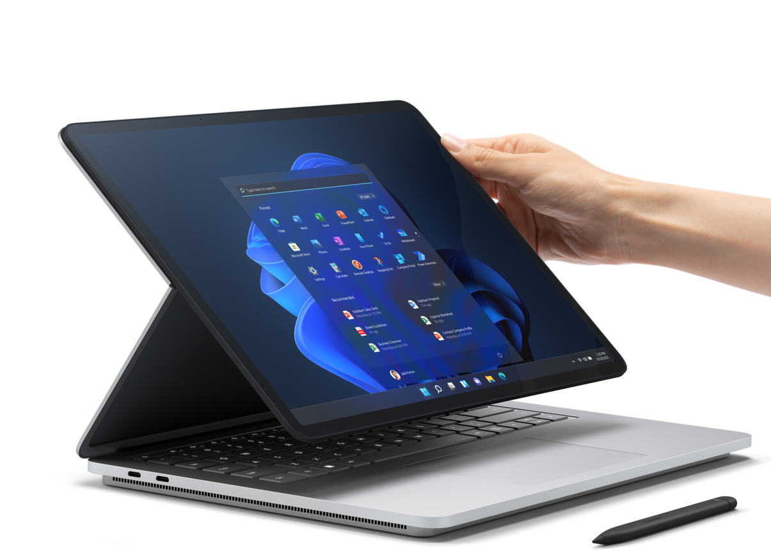
For more information on Surface for Nonprofits, contact us today.

