Slide 1

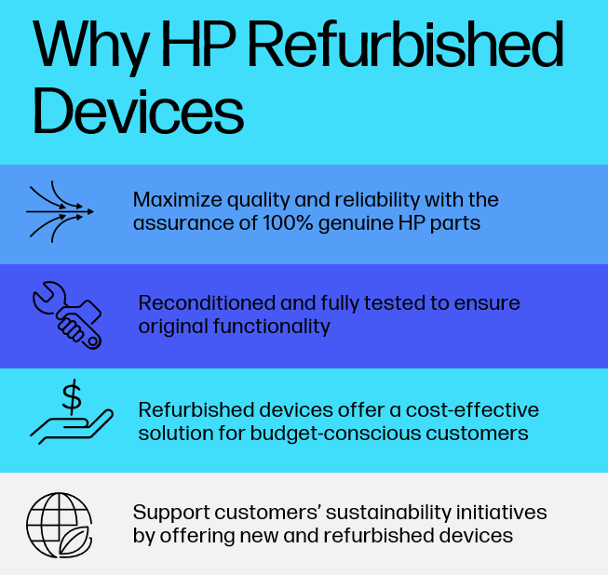
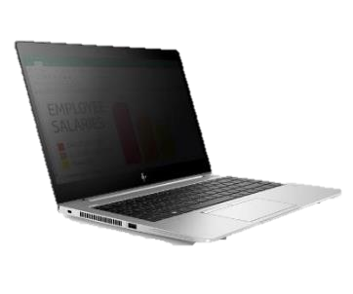
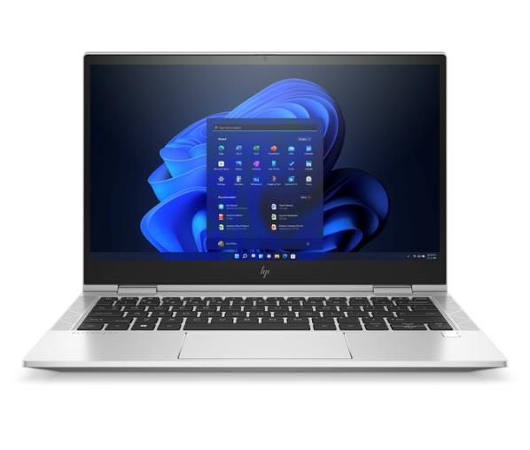
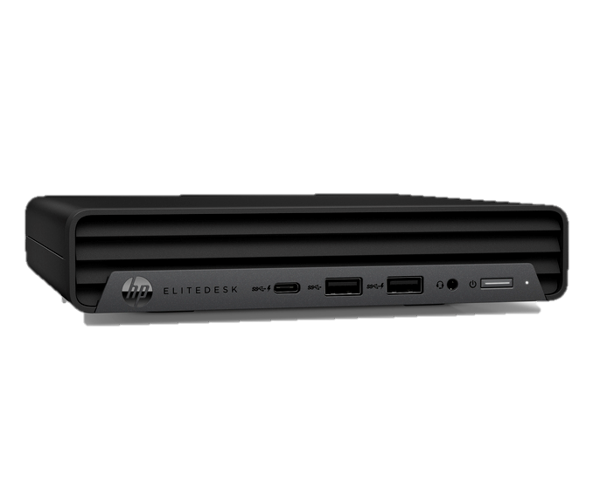
HP Renew
Looks like New. Works like New. Costs Less. Rebuilt to last and priced to impress.
Refurbishment Standards
Multi-Point Inspection
End-to-End Cosmetic Repair
PCs are wiped to NIST Standards
Robust Battery Testing*
Windows 11 and 16GB Memory
1-Year HP Factory Warranty**
OEM Original Part Replacement
Repacked w/Manual and Cords
Updated with the latest compatible versions of BIOs, firmware, drivers, and HP-approved platform image
Sustainable Packaging
*Batteries <90% FCC are replaced.
**G6 devices come with a 1-Year Factory Warranty.
G7/G8 devices come with a 1-Year Factory Warranty, Plus, eligible for up to a 3-Year Care Pack Extended Support.
Current Inventory
*Subject to change
EliteBook 840 G5 and G6
EliteBook 830/840 G7
EliteBook 840 G8
EliteDesk Mini 800 G6
Tariff free
Save up to 50% Vs. New
Ready-To-Ship Inventory

